Slide 1

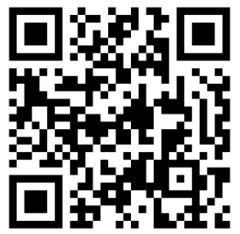
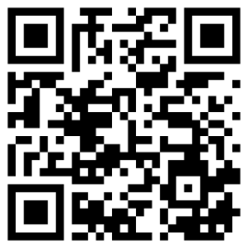


Meeting - May 14, 2026
Meeting sponsored by
AND
CANSUG FORUM
LinkedIN
www.cansug.ca
Wifi: Touchdown Guest
Password: Guest101

Slide 2
Agenda
9:00 Welcome, introductions (online meeting starts)
9:15 CANSUG announcements
9:30 Month-end Automation (Rebecca Balaz, 1Password)
10:15 Finance Questions (submitted at registration)
10:45 Sponsor: Traild (Jasper Harlaar)
10:55 Break
11:05 Saved Search Formulas (Mark Tanner, Kalpa Inc)
11:30 Data Migration: The CSV Import Tool & Updating Records
(Paul Giese, OptimalData Consulting)
12:30 Wrap-up

Slide 3
Board Members
Mark Tanner, Co-Chair
Gavin Davidson, Co-Chair
Lisa Reed, Treasurer
Stephanie Frisina, Co-Membership Chair
Darcie Vany, Recording Secretary
Paul Stanchev, Speaker Chair
Kenny Hunter, Tech Advisor / Developer
Our goal:
Create networking opportunities
Help with education on NetSuite related topics
Share knowledge and experiences
Friendly learning environment
Listen to your needs
Voice for change
Online and In-Person Meetings
No membership cost
This group is neither owned or managed directly by Oracle NetSuite.

Slide 4
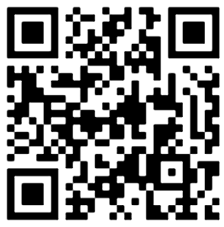
Announcements
Welcoming additional Board members to grow our membership
Lunch Box Series – Every 2nd Tuesday on the month
CANSUG live forums (skool platform)
Feedback for upcoming in-person sessions (Quarterly)
NetSuite SuiteWorld – Oct 25-28 (Las Vegas)
CANSUG live forums

Slide 5
Sponsors
ERP-integrated solution for Accounts Payable focused on the twin issues of AP efficiency and financial security
Effortlessly transition your detailed legacy financial data during your NetSuite implementation

Slide 6
Month-end Automation
Rebecca Balaz, 1Password

Slide 7
Financial Q&A
Kim:
How can you create a rolling 13-week cash flow forecast?
Can be done with a saved search, SuiteAnalytics or SuiteApp: Cash 360

Slide 8
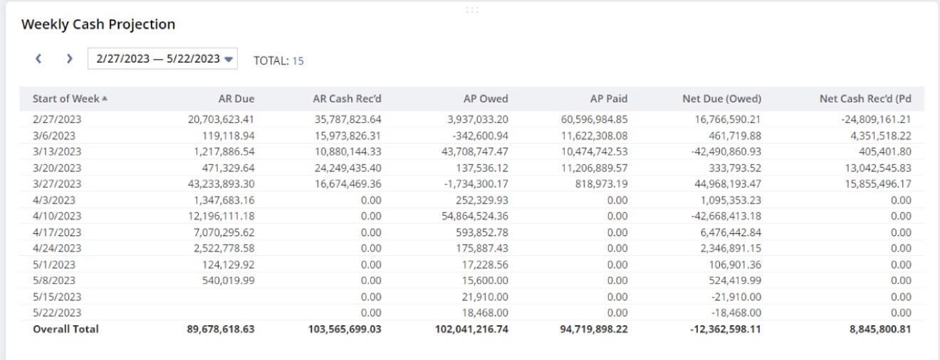
Financial Q&A

Slide 9
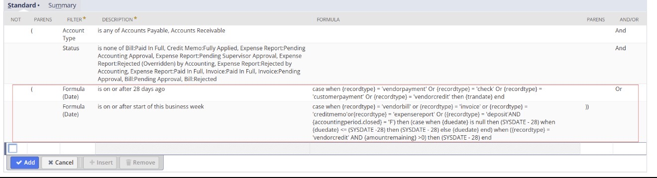
Financial Q&A
to make the starting week dynamic, you can change the below criteria red highlighted portion as needed

Slide 10
Financial Q&A
Mahak:
Revenue recognition by project- mix of T&M and fixed fee projects : WIP process

Slide 11
Financial Q&A
NetSuite best practice indicates that T&M projects should be direct posting as long as they are billed monthly.
Fixed fee projects are typically done % complete.
You also should not mix them on a single project if they are treated like they are above, because you cannot put revenue recognition items and non-revenue recognition items on the same transaction.
Natively, it’s always the % complete schedule on the project that governs the schedule.
A few ways to manage it -
  Manually insert a value per project each month
  Derive a customization to compute it for your account
  Use partner packaged solutions that are designed to work for this use case - there are numerous job costing solutions in the market, one example is PCT which is used by some of our clients.

Slide 12
Financial Q&A
Gerald:
What do you have available for Canadian payroll processing?

Slide 13
Financial Q&A
NetSuite options - partner named Aarialife has a pre-built solution in NetSuite (Paybuddy), Zone & Co are also well known for it’s Zonepay solution.
There are other options in the market.
Mainstream solutions outside of NetSuite, that integrate very well to NetSuite.
Options are -
  ADP
  UKG
  Zoho Payroll
  Rippling
  Deel
Typically, when we recommend to our clients, we tend to suggest the ones that are outside of NetSuite. They’re better costed, integrating it isn’t super difficult, and they take care of reporting remittances to CRA more robustly due to the extensive client base they are used to managing.

Slide 14
Financial Q&A
Vivienne:
Best practice in NetSuite to review GRIR account. It's currently very manual

Slide 15
Financial Q&A
Good Received/Invoice Received is usually managed using the Accrued Purchasing Account in NetSuite.
When an IR is logged, this liability is recorded using the quantity received on the Item Receipt and the rate defined for the item on the PO.
Typically, the challenge arises on Invoice Received where the item receipt amount isn’t the same, either due to a quantity variance, rate variance, or an exchange rate variance.
The most native way to manage this is by using the variance posting process in NetSuite.
This allows you to keep track of the variance wherever there is a difference.
Saved searches are created by PO by item and grouping the debits and credits of the Accrued Purchase Account and the Variance account, and the balance per transaction cycle should eventually equal zero.

Slide 16
Financial Q&A
David:
AI Integration with NS and impact on HIPAA or PIPEDA?
Anna-Lisa:
How to incorporate AI such as Claude into NetSuite and what it can do to help with the company's day to day, budgeting, and reporting.
Harleen:
How are other companies using MCP? Interested to see if any companies are using it for Change Management documentation.

Slide 17
Sponsor
ERP-integrated solution for Accounts Payable focused on the twin issues of AP efficiency and financial security

Slide 18
Break
Resuming at 11:10

Slide 19
Saved Search Formulas
Mark Tanner, Kalpa Inc

Slide 20
Saved Search Formulas
 | Record Type | Purpose | Link
1 | Item Receipt | POs with item Receipts but no Vendor Bill | Link
2 | Invoice | Invoice Aging Bucket | Link
3 | Payment | Average Days to Pay | Link
4 | Projects | Project Cost Overburn Flag | Link
5a | Customer | non-Clickable Record Link | Link
5b | Customer | Clickable Record Link | Link
6 | Transactions | Concat field data | Link

Slide 21
Data Migration: The CSV Import Tool
& Updating Recording
Paul Giese, OptimalData Consulting

Slide 22
Closing remarks
Event Survey
Lunch Box Series - June 11th
Summer In-person – TBA

